Slide 1

Analytics for Operations and Logistics Management
Eco Drive Motors: Performance & Sustainability Analysis (2022–2025)
Student name:
Student id:

Slide 2
Introduction: Eco Drive Motors Overview
Eco Drive Motors brings its business in a competitive business environment in the automotive industry that gives the consumer options of Petrol, Diesel, Electric and Hybrid cars.
The dataset that we track is on sales, revenue, customers, geography, and emissions in 2022 to 2025.
Power BI dashboard represents trends in performance and sustainability.
The analysis assists the leaders to make strategic choices that expand the business and preserve the environment.
Notes:
The presentation is the overview of commercial development and sustainability at Eco Drive motors with interactive Power BI dashboards that focus on four selected KPIs that will align the business objectives and the eco-social agenda.

Slide 3
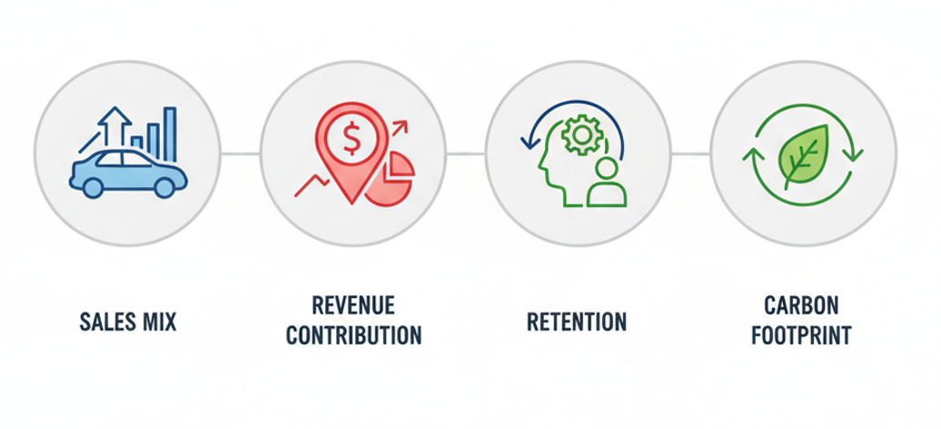
KPI Framework & Dashboard Structure
The four KPIs are selected are more balanced between financial performance and sustainability.
They are sales mix, regional revenue, customer behavior and reduction of carbon footprints.
Two KPIs appear in each dashboard canvas and therefore the data is easily interpreted.
Interactive slicers enable users to do year, model or region drilling.
Notes:
The KPI system is designed such that it provides a comprehensive insight into business wellbeing including profitability, market penetration, customer retention, and environmental footprint in a single analytical framework.

Slide 4
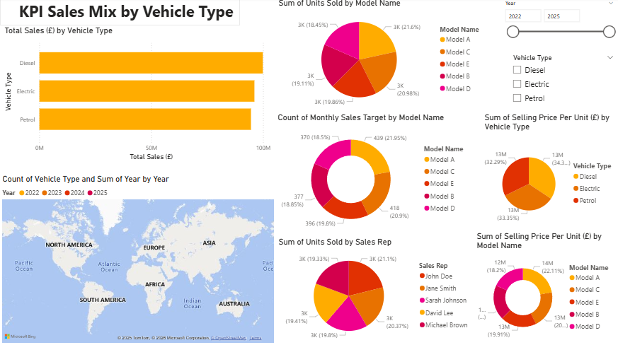
KPI 1: Sales Mix by Vehicle Type (Overview)
Each Petrol, Diesel and Electric model has sales revenue of approximately 100 million PS.
The portfolio is diversified and has a balanced presence of no type of vehicle predominance.
The petrol models are slightly higher in price per unit as compared to others.
Sales of electric are increasing at high speed despite infrastructure barriers.
Balanced sales across Petrol, Diesel, and Electric (~£100M each)
Petrol slightly higher unit price (34.36%)
Model A leads units sold (21.6%)
Targets aligned with demand (Model A & C highest)
Notes:
Eco Drive Motors has a healthy multi-fuel strategy with a balanced sales mix. Such diversification reduces the risks of dependency and sets the company in a very good position to grow in the electric mobility markets in future.

Slide 5
KPI 1: Sales Mix Trends & Insights
The type of vehicles has a close correlation between unit sales and revenue share.
Market transition challenges do not nullify the similar value that electric vehicles bring forth in the market.
Sales goals are similar to the past distribution and a good indicator of successful forecasting (Wagner et al. 2025).
Both stable trends between 2022 and 2025 depict stable consumer demand trends.
Sales team performance consistent across reps
John Doe leads with 21.1% units sold
Global reach indicated by map visualization
Longitudinal study across 2022–2025 highlights growth trends
Notes:
Sales mix stability over the years is an indication of a predictable demand; therefore, the managers may be assured of production planning. It also facilitates the process of shift to a sustainable vehicle portfolio, which helps to achieve the long-term strategic objectives.

Slide 6
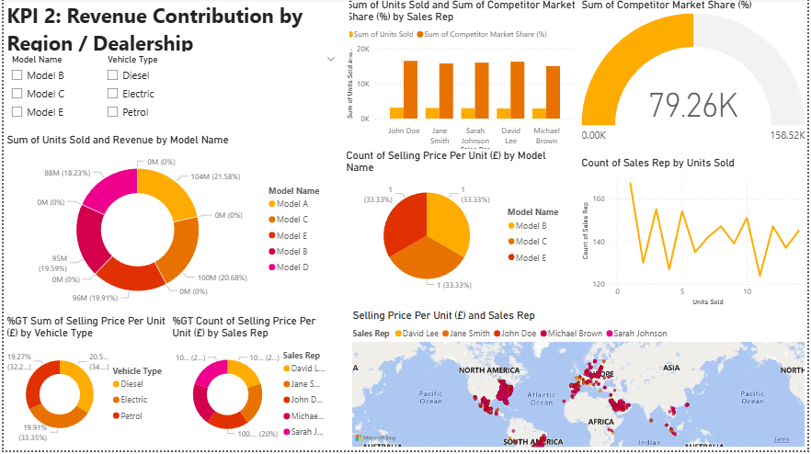
KPI 2: Revenue Contribution by Region (Overview)
In Europe and along the coast of North America the highest revenue concentration can be found.
The revenue contribution of emerging markets is less meaning that there is a potential to be exploited.
The difference in regional performance identifies the gap in infrastructure and market maturity.
Geographic slicers bring a comparison of the performance during years and regional level.
Revenue balanced across models A–E
Model A (21.58%) and Model C (20.68%) lead
Competitor market share at 79.26K vs. 158.52K capacity
Strong presence in Europe & coastal North America
Notes:
The regional analysis indicates the existing strong points of Eco-Drive Motors and shows the unexploited markets where the specific growth might open wide new areas of revenue and lead to overall development of the company in terms of the long-term strategic success and market leadership.

Slide 7
KPI 2: Regional Performance Gaps
Mature regions provide consistent revenue with a low degree of volatility in terms of its growth.
The barriers to underperforming regions can be the charging facilities or cost.
In-depth knowledge on dealer level helps in creating targeted incentives and local approaches (Sangeetha et al. 2025).
Regional diversification minimizes the risk to economic shocks.
Selling price contribution: Electric & Diesel ~32–34%
Sales reps consistent but below competitor volumes
Gauge chart shows strong market capacity utilization
Volatility in reps closing higher unit volumes
Notes:
Understanding of regional differences puts a leadership into the position to ensure investments, a pricing approach and improvement of dealership operations in the laggard markets to expand the market penetration and customer satisfaction to enhance long-term growth and success.

Slide 8
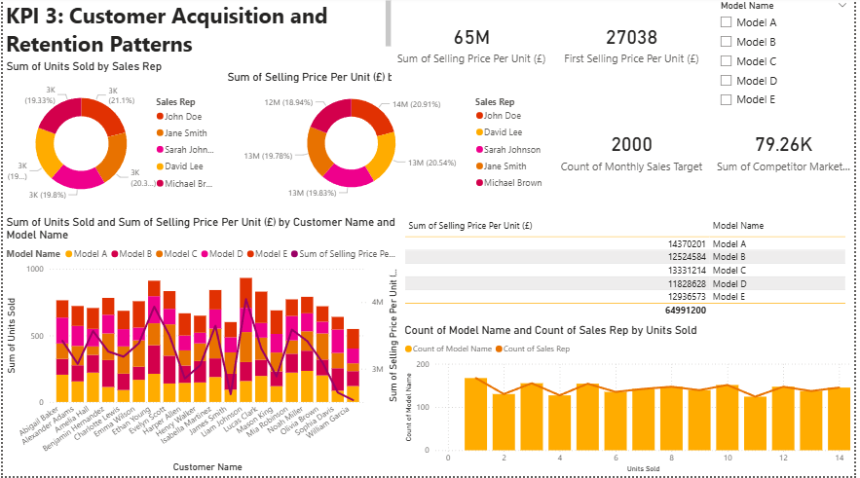
KPI 3: Customer Acquisition & Retention (Overview)
The number of sales is balanced among the five major sales representatives (~20% each).
They do not show any over dependency on one salesperson or a customer base.
The unit-selling price is PS65M, which demonstrates a high level of customer value.
There is no change in the acquisition of customers throughout the period of analysis.
Total selling price per unit: £65M
Monthly sales target: 2,000 units
Model A highest revenue (£14.37M), Model D lowest (£11.82M)
Customers purchase across all models, showing diversified interest
Notes:
Having a balanced sales force and a wide customer base, Eco-Drive Motors will be resilient, providing the company with stable performance and securing growth even in a fluctuating market hence protecting the long-term profitability of future operations.

Slide 9
KPI 3: Customer Behavior Patterns
Customers do not often buy one and the same product they buy several models of vehicles.
The value customers enable high revenue generation because of the repeat purchasing.
Some customers can exhibit premium preferences even though unit volumes can be lower.
There is a positive correlation in sales volume and selling price.
Sales reps contribute equally (~20% each)
High-value customers: Lucas Clark, James Smith, Ethan Young
Correlation between units sold and total spend
Premium models drive higher spend despite lower volumes
Notes:
Diversified buying patterns among customers indicate that the brand has high trust and customer retention where the range of products purchased caters to all segments and reduces the revenues of any particular model that might result in fluctuations of revenues during changes in the market.

Slide 10
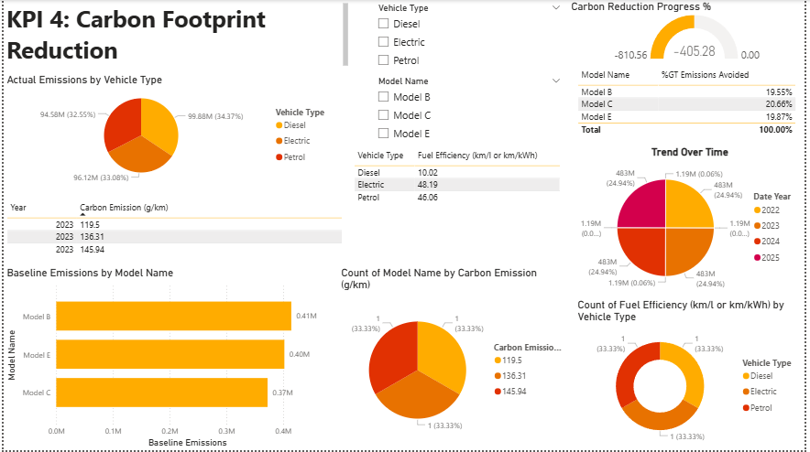
KPI 4: Carbon Footprint Reduction (Overview)
Emissions split: Petrol (34.37%), Diesel (32.55%), Electric (33.08%)
Efficiency: Electric (48.19 km/kWh), Petrol (46.06 km/l), Diesel (10.02 km/l)
Model B highest emissions (0.41M)
Model C most effective in emission avoidance (20.66%)
The distribution of the Emissions is balanced between the Petrol, diesel, and Electric vehicles.
EVs do not fail to produce emissions because of the sources of electricity generation.
There is much less fuel efficiency with diesel cars.
The emissions track allows monitoring the sustainability performance.
Notes:
The carbon-footprint dashboard demonstrates the complexity of the task of emission reduction and highlights the fact that electrification does not guarantee the achievement of sustainability benefits by itself. Business and planet need to find ways of making the environmental changes meaningful through integrated strategies.

Slide 11
KPI 4: Emissions Trends & Performance
The maximum level of carbon emissions is of around 145.94/km in 2023.
The highest baseline emissions is produced by model B.
The model C brings the highest level of emissions avoidance good.
The total progress in carbon reduction continues to be negative.
Emissions split: Petrol (34.37%), Diesel (32.55%), Electric (33.08%)
Efficiency: Electric (48.19 km/kWh), Petrol (46.06 km/l), Diesel (10.02 km/l)
Model B highest emissions (0.41M)
Model C most effective in emission avoidance (20.66%)
Notes:
Statistics show that an immediate necessity exists to refocus product strategy and practice, turn around increasing emissions and fulfil the environmental promises made in the long-term so that the brand image is safe and compliant development of the future is also guaranteed.

Slide 12
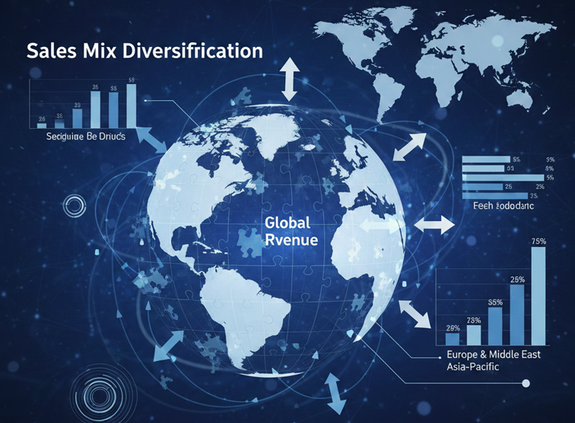
KPI Rationale: Sales & Revenue KPIs
Sales mix tells us the consumer preference and readiness on EVs in the market.
The contribution of revenue determines the locations of strong and poor performance.
These KPIs directly have an effect on profitability and investments planning (Mai et al. 2025).
The two KPIs facilitate both short and long term strategic choices.
Notes:
These KPIs assist Eco-Drive Motors to strike a balance between commercial performance and environmental sustainability, and recovery toward stakeholder expectations and create a strong brand to make a global impact by balancing profit with sustainability and trust to the society.

Slide 13
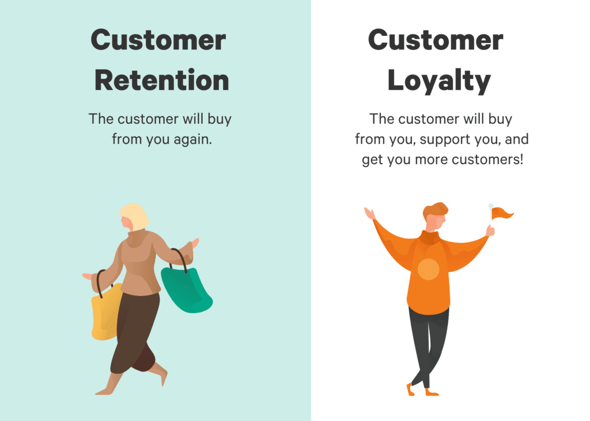
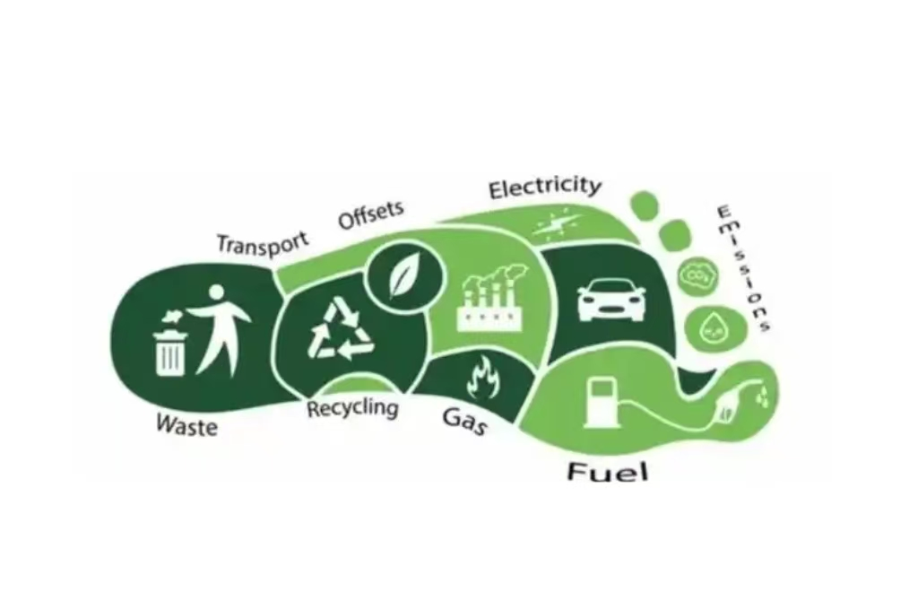
KPI Rationale: Customer & Sustainability KPIs
Customer KPIs are stability, loyalty, and potential growth.
Retention lowers the cost of acquisition and lifespan (Luxembourg et al. 2025).
Carbon KPIs ensure that business strategy and ESG and 2030 objectives match.
Sustainability ratios help improve brand image and governance.
Notes:
Individual sales and market oriented will enhance growth, facilitating easier shifts toward sustainable mobility solutions and enhancing the market leadership of Eco interested Motors, as well as customer loyalty mediation of revenues streams over sustained growth.

Slide 14
Recommendations: Sales & Market Strategy
Phase out Diesel vehicles to improve efficiency
Strengthen premium model marketing for higher revenue
Enhance sales rep training to reduce volatility
Improve emission tracking & align with 2030 goals
Enhance use of incentives on Electric and Hybrid vehicles.
Regional strategy adjustment by infrastructure preparedness.
Do forecasting sales on a fine basis (International Energy Agency, 2023).
Enhance poor performer dealership networks.
Notes:
Individual sales and market oriented enhances growth, facilitating easier shifts toward sustainable mobility solutions and enhancing the market leadership of Eco interested Motors, as well as customer loyalty mediation of revenues streams over sustained growth.

Slide 15

Recommendations: Customer & Sustainability Actions
Establish customer reward schemes on repeat buyers.
Train sales force to favour sustainability advantages.
Gradually eliminate low efficiency Diesel models (Gujar, 2025).
Invest into EV charging partnerships in renewable energy.
Notes:
The engagement of customers and investments in sustainability should move in tandem, retaining, reducing emissions, and developing long-term competitive edge that will place Eco-Drive Motors ahead in an evolving market to succeed in the future.

Slide 16
Conclusion
BI dashboard reports are actionable and real-time.
KPIs show that it is very financially stable and has sustainability issues.
Informed recommendations help in 2030 strategic objectives.
The sources are dataset, scholarly literature, and industrial reports.
Notes:
This analysis equips leadership with clear, evidence-based insights to drive profitable growth while advancing Eco Drive Motors’ sustainability agenda.

Slide 17
Reference list
Gujar, P., 2025. Data Visualization: Techniques and Best Practices. In Data Usability in the Enterprise: How Usability Leads to Optimal Digital Experiences (pp. 143-178). Berkeley, CA: Apress. https://link.springer.com/chapter/10.1007/979-8-8688-1183-8_6
International Energy Agency (IEA) (2023) Global EV Outlook 2023: Catching up with climate ambitions. Paris: IEA. https://www.iea.org/reports/global-ev-outlook-2023
Luxembourg, S.L., Salim, S.S., Smekens, K., Longa, F.D. and van der Zwaan, B., 2025. TIMES-Europe: An integrated energy system model for analyzing Europe’s energy and climate challenges. Environmental Modeling & Assessment, 30(1), pp.1-19. https://link.springer.com/article/10.1007/s10666-024-09976-8
Mai, L., Liu, M., Hao, H., Sun, X., Meng, F., Geng, Y., Wadud, Z., Tate, J.E., Dong, Z., Li, H. and Geng, J., 2025. A high-resolution dataset on electric passenger vehicle characteristics in China and the European Union. Scientific Data, 12(1), p.1449. https://www.nature.com/articles/s41597-025-05770-7
Sangeetha, R., Elantamilan, D. and Indrapandi, A., 2025. Analyzing Data with Different Charts and Visualizations in Power BI. Metallurgical and Materials Engineering, 31(1), pp.780-785. https://metall-mater-eng.com/index.php/home/article/view/1310
Wagner, A., Walker, A.M., Albizzati, P.F., Milios, L., Besler, M., Pedauga, L., Rostek, L., Keramidas, K., Piñero Mira, P., Christis, M. and Fonteyn, P., 2025. Environmental and Socio-Economic Impacts of the Circular Economy Transition in the EU Steel Sector [online] https://publica.fraunhofer.de/bitstreams/06120dcc-cb4f-42e7-9272-ce94daf04810/download

Slide 18
THANK YOU

